Slide 1
Discrete Structures
Instructor: Zubaria Asma
Course Code: CS-335
Credit Hours: 3(3-0)
Lecture # 13

Slide 2
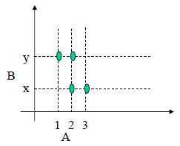
COORDINATE DIAGRAM (GRAPH) OF A RELATION
Let A = {1, 2, 3} and B = {x, y}
Let R be a relation from A to B defined as
R = {(1, y), (2, x), (2, y), (3, x)}
The relation may be represented in a coordinate diagram as follows:
Notes:
Today we will discuss how to represent set into graph
For this I need relation
Relation will be taken by multiplying one set element with other set element(in case we are not being given a relation)so we have to take cartisian products
Then we have to plot graph(which is called coordinate graph)

Slide 3
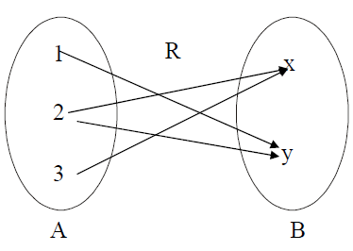
ARROW DIAGRAM OF A RELATION
Let
A = {1, 2, 3}, B = {x, y} and
R = {1,y), (2,x), (2,y), (3,x)}
be a relation from A to B.
The arrow diagram of R is:
Notes:
R to be given or to be find through cartisian product,
Here the relation is given already

Slide 4
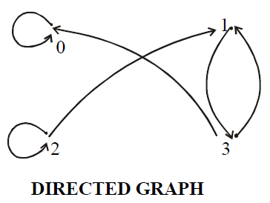
DIRECTED GRAPH OF A RELATION
Let A = {0, 1, 2, 3} and R = {(0,0), (1,3), (2,1), (2,2), (3,0), (3,1)} be a binary relation on A.

Slide 5
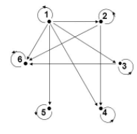
Example
Let A={1,2,3,4,5,6} R is the relation on A defined by the following directed graph. Write down the relations for the graph shown below;

Slide 6
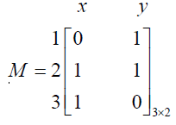
EXAMPLE
Let A = {1, 2, 3} and B = {x, y}
Let R be a relation from A to B defined as
R ={(1,y), (2,x), (2,y), (3,x)}
The matrix representation for R is:

Slide 7
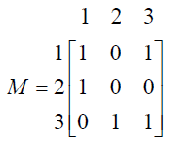
EXAMPLE
For the relation matrix
List the set of ordered pairs represented by M
Draw the directed graph of the relation

Slide 8
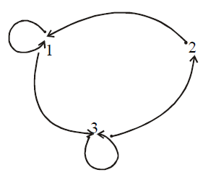
solution
The relation corresponding to the given Matrix is
R = {(1,1), (1,3), (2,1), (3,2), (3,3)}
And its Directed graph is given below:

Slide 9

MATRIX REPRESENTATION OF A RELATION
Let A = {a1, a2, …, an} and B = {b1, b2, …, bm}. Let R be a relation from A to B. Define the n × m order matrix M by
for i=1,2,…,n and j=1,2,…,m

Slide 10
EXERCISE
Let A = {2, 4} and B = {6, 8, 10} and define relations R and S from A to B as follows:
for all (x,y) ∈A × B, x R y ⇔ y % x
for all (x,y) ∈A × B, x S y ⇔ y – 4 = x
State explicitly which ordered pairs are in A × B, R, S, R∪S and R∩S.
SOLUTION
A × B = {(2,6), (2,8), (2,10), (4,6), (4,8), (4,10)}
R = {(2,6), (2,8), (2,10), (4,8)}divisible..
S = {(2,6), (4,8)}
R ∪ S = {(2,6), (2,8), (2,10), (4,8)}= R
R ∩ S = {(2,6), (4,8)}= S

Slide 11
FUNCTION
A function f from a set X to a set Y is a relationship between elements of X and elements of Y such that each element of X is related to a unique element of Y, and is denoted f : X →Y.
The set X is called the domain of f and Y is called the co-domain of f.
Arrow diagram for a function f has the following two properties:
Every element of X has an arrow coming out of it
No two elements of X has two arrows coming out of it that point to two different elements of Y.
Notes:
Each arrow from each element of domain to co-domain

Slide 12
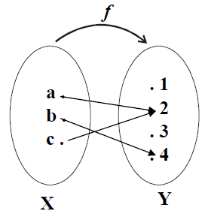
Let X = {a, b, c} and Y={1,2,3,4}.
Define a function f from X to Y by the arrow diagram.

Slide 13
RELATIONS AND FUNCTIONS
A function F from a set X to a set Y is a relation from X to Y that satisfies the following two properties
For every element x in X, there is an element y in Y such that (x,y) ∈F. In other words every element of X is the first element of some ordered pair of F.
For all elements x in X and y and z in Y, if (x,y) ∈F and (x,z) ∈F, then y = z. In other words no two distinct ordered pairs in F have the same first element.

Slide 14
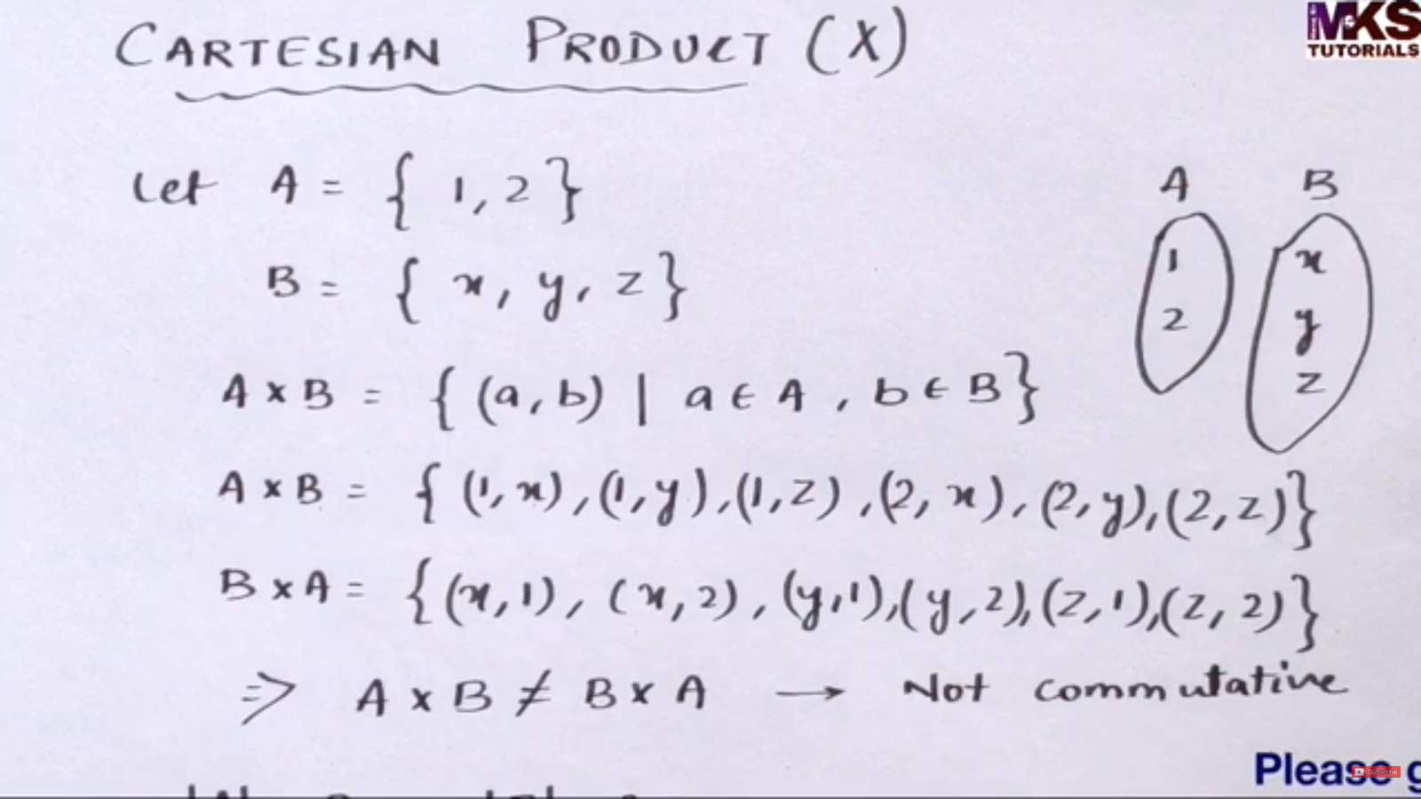
Notes:
(a represents all elements belongs to A,,,)
(1,x)(1,y)… are ordered pairs…

Slide 15
example
Which of the relations define functions from X = {2,4,5} to Y={1,2,4,6}.
R1 = {(2,4), (4,1)}
R2 = {(2,4), (4,1), (4,2), (5,6)}
R3 = {(2,4), (4,1), (5,6)}
R1 is not a function, because 5 ∈X does not appear as the first element in any ordered pair in R1.
R2 is not a function, because the ordered pairs (4,1) and (4,2) have the same first element but different second elements.
R3 defines a function because it satisfy both the conditions of the function that is every element of X is the first element of some order pair and there is no pair which has the same first order pair but different second order pair.

Slide 16
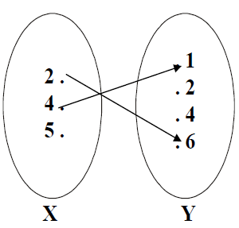
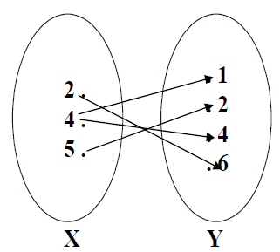
FUNCTIONS AND NONFUNCTIONS
Which of the arrow diagrams define functions??

Slide 17

THANK YOU

